Slide 1
ENVIRONMENTAL APPLICATIONS OF ENZYMES.

Slide 2
INTRODUCTION
Environmental applications of enzymes are basically related to environmental conservation. By using enzymes, biotechnology can potentially transform wastes or pollutants to less harmful or useful components through bioremediation. Bioremediation is the use of microbes to clean up waste from the environment.

Slide 3


Slide 4
Organic deposit management.
Organic deposit could be present in water or on land. Water could have a variety of organic deposits which include plastics,detergent,oil spills etc.
Biological wastes are treated with hydrolases to degrade biological polymers in a pre treatment step.
Enzyme producing bacteria break down organic waste by utilizing them as a source of hydro carbons and nitrogen.
Oxidoreductases are involved in the oxidative degradation of the wastes. This increases the quality of waste water effluent;cellulases,peroxidases and ligninases are the most important for bleaching effluents.

Slide 5
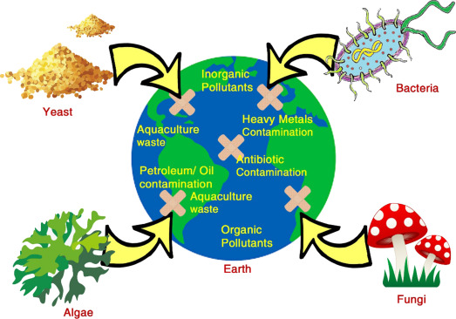

Slide 6
Fungal ligninolytic enzymes such as laccases and certain fungal class 2 peroxidases from white rot basidiomycetes are considered in degradation of persistent organic pollutants such as PCBS and DDT.
Bacteria secretase enzymes used to clean up oil spills such as alkane hydroxylases; are alkane degrading enzymes that are distributed among different species of bacteria, yeast and algae.
This kind of biodegradation of hydro carbons can occur in presence or absence of oxygen; under aerobic conditions, oxygenase enzymes introduce oxygen atoms into hydro carbons hence degrading the oil spills.

Slide 7
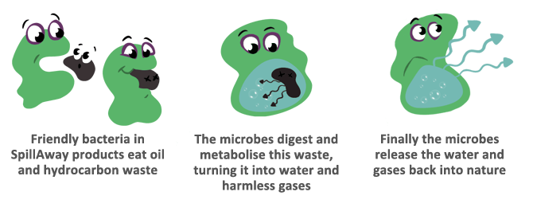

Slide 8
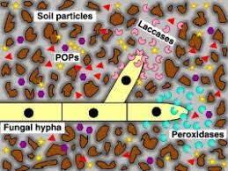

Slide 9
In addition, on land plastics can be degraded by laccases from fungi. Oxidoreductases,cellulases,lyases , ligninases are used to degrade specific pollutants in nature e.g. pulp,paper,textile and beverage.
Enzymes can also be utilized in bio monitoring which involves chemical analysis of defined pollutants; hepatic cytochromes from wild rodents can be used as bio indicators in detecting toxic substances.
Oxidoreductases e.g. nitrate reductase detect and quantify heavy metals in biological systems.
Isomerase detects mercury in the environment.

Slide 10
conclusion
This illustrates the remarkable potential enzymes have in environmental conservation.

Slide 11


